Slide 1
Week11a
WARMUP
What does this print?
PRINT(0.1 + 0.2);
PRINT(SQRT(2.0) * SQRT(2.0));
the Fibonacci sequence
recursion
dynamic programming
🦜🦜🦜🦜🦜🦜🦜🦜🦜🦜🦜
🍉
WARMUP
What is F₇?
F₀ = 0
F₁ = 1
F_{k} = F_{k - 1} + F_{k - 2}

Slide 2
what are these?
🍉

Slide 3

the

Slide 4
👼

Slide 5
[record lecture]

Slide 6
the Fibonacci sequence

Slide 7


Slide 8
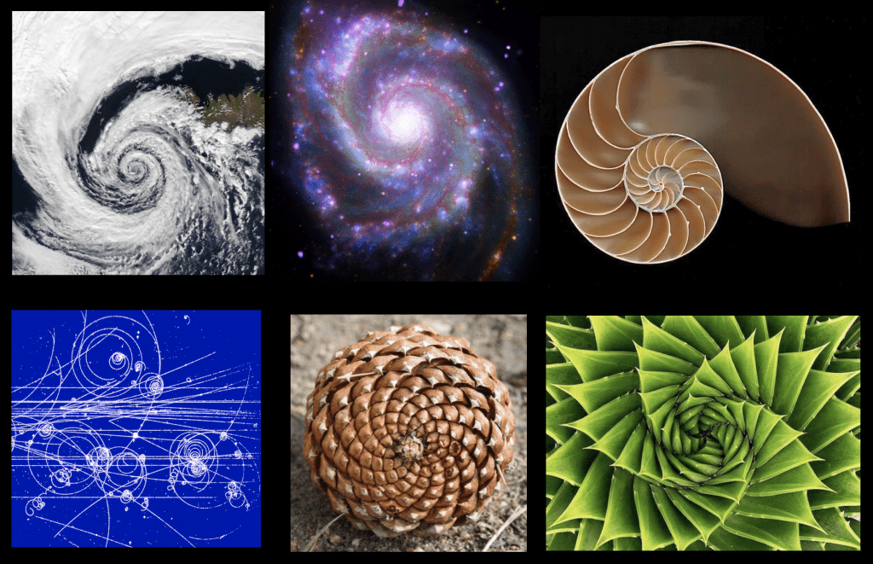

Slide 9
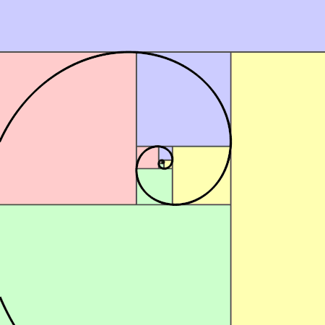

Slide 10


Slide 11
// F_0 = 0
// F_1 = 1
// F_2 = F_1 + F_0 = 1 + 0 = 1
// F_3 = F_2 + F_1 = 1 + 1 = 2
// F_4 = F_3 + F_2 = 2 + 1 = 3
// F_5 = F_4 + F_3 = 3 + 2 = 5
// F_6 = F_5 + F_4 = 5 + 3 = 8
// F_7 = F_6 + F_5 = 8 + 5 = 13
// ...

Slide 12
recursion

Slide 13
review: recursion basics

Slide 14
recursion
a recursive function is a function that calls itself
each call must make progress towards a base case (when the function finally returns without calling itself)
✨ when in doubt, try something like zero for your base case
class Main {
static int digitSum(int n) {
if (n == 0) {
return 0;
}
return digitSum(n / 10) + (n % 10);
}
public static void main(String[] arguments) {
PRINT(digitSum(256)); // 13
}
}

Slide 15
static int digitSum(int n) {
if (n == 0) {
return 0;
}
return digitSum(n / 10) + (n % 10);
}
return 0;
return digitSum(0) + 2;
return digitSum(2) + 5;
return digitSum(25) + 6;
int a = digitSum(256);

Slide 16
static int digitSum(int n) {
if (n == 0) {
return 0;
}
return digitSum(n / 10) + (n % 10);
}
return 0;
return digitSum(0) + 2;
return digitSum(2) + 5;
return digitSum(25) + 6;
int a = digitSum(256);

Slide 17
static int digitSum(int n) {
if (n == 0) {
return 0;
}
return digitSum(n / 10) + (n % 10);
}
return 0 + 2;
return digitSum(2) + 5;
return digitSum(25) + 6;
int a = digitSum(256);

Slide 18
static int digitSum(int n) {
if (n == 0) {
return 0;
}
return digitSum(n / 10) + (n % 10);
}
return 2;
return digitSum(2) + 5;
return digitSum(25) + 6;
int a = digitSum(256);

Slide 19
static int digitSum(int n) {
if (n == 0) {
return 0;
}
return digitSum(n / 10) + (n % 10);
}
return 2;
return digitSum(2) + 5;
return digitSum(25) + 6;
int a = digitSum(256);

Slide 20
static int digitSum(int n) {
if (n == 0) {
return 0;
}
return digitSum(n / 10) + (n % 10);
}
return 2 + 5;
return digitSum(25) + 6;
int a = digitSum(256);

Slide 21
static int digitSum(int n) {
if (n == 0) {
return 0;
}
return digitSum(n / 10) + (n % 10);
}
return 7;
return digitSum(25) + 6;
int a = digitSum(256);

Slide 22
static int digitSum(int n) {
if (n == 0) {
return 0;
}
return digitSum(n / 10) + (n % 10);
}
return 7;
return digitSum(25) + 6;
int a = digitSum(256);

Slide 23
static int digitSum(int n) {
if (n == 0) {
return 0;
}
return digitSum(n / 10) + (n % 10);
}
return 7 + 6;
int a = digitSum(256);

Slide 24
static int digitSum(int n) {
if (n == 0) {
return 0;
}
return digitSum(n / 10) + (n % 10);
}
return 13;
int a = digitSum(256);

Slide 25
static int digitSum(int n) {
if (n == 0) {
return 0;
}
return digitSum(n / 10) + (n % 10);
}
return 13;
int a = digitSum(256);

Slide 26
static int digitSum(int n) {
if (n == 0) {
return 0;
}
return digitSum(n / 10) + (n % 10);
}
int a = 13;

Slide 27
fin.

Slide 28
⚠️ recursion hazard 1 repeated computation

Slide 29
🐌 example: slow very slow fibonnaci (couldn't we just use a for loop...?)
// F_0 = 0
// F_1 = 1
// F_2 = F_1 + F_0 = 1 + 0 = 1
// F_3 = F_2 + F_1 = 1 + 1 = 2
// F_4 = F_3 + F_2 = 2 + 1 = 3
// F_5 = F_4 + F_3 = 3 + 2 = 5
// ...
static long fib(int k) {
if (k == 0) { return 0; }
if (k == 1) { return 1; }
return fib(k - 1) + fib(k - 2);
}

Slide 30
fib(4)

Slide 31
(fib(3) + fib(2))

Slide 32
((fib(2) + fib(1)) + (fib(1) + fib(0)))

Slide 33
(((fib(1) + fib(0)) + fib(1)) + (fib(1) + fib(0)))

Slide 34
(((1 + 0) + 1) + (1 + 0))

Slide 35
((1 + 1) + 1)

Slide 36
(2 + 1)

Slide 37
3

Slide 38
fib(4)

Slide 39
fib(4)
fib(3)
fib(2)

Slide 40
fib(4)
fib(3)
fib(2)
fib(2)
fib(1)

Slide 41
fib(4)
fib(3)
fib(2)
fib(2)
fib(1)
fib(1)
fib(0)

Slide 42
fib(4)
fib(3)
fib(2)
fib(2)
fib(1)
1
0

Slide 43
fib(4)
fib(3)
fib(2)
1
fib(1)

Slide 44
fib(4)
fib(3)
fib(2)
1
1

Slide 45
fib(4)
2
fib(2)

Slide 46
fib(4)
2
fib(2)
fib(1)
fib(0)

Slide 47
fib(4)
2
fib(2)
1
0

Slide 48
fib(4)
2
1

Slide 49
3

Slide 50
🙂

Slide 51
☹️

Slide 52
3

Slide 53
fib(4)

Slide 54
fib(4)
fib(3)
fib(2)
fib(2)
fib(1)
fib(1)
fib(0)
😱 what about this picture does NOT spark joy?
fib(1)
fib(0)

Slide 55
fib(4)
fib(3)
fib(2)
fib(2)
fib(1)
fib(1)
fib(0)
fib(1)
fib(0)

Slide 56
we computed fib(2) from scratch two seperate times 😱 we are repeating computation! (what a waste 😞)

Slide 57
and for bigger n... there is (much) more repetition

Slide 58
F₆
F₄
F₅
F₂
F₃
F₃
F₄
F₀
F₁
F₁
F₂
F₁
F₂
F₂
F₃
F₀
F₁
F₀
F₁
F₀
F₁
F₁
F₂
F₀
F₁

Slide 59

F₆
F₄
F₅
F₂
F₃
F₃
F₄
F₀
F₁
F₁
F₂
F₁
F₂
F₂
F₃
F₀
F₁
F₀
F₁
F₀
F₁
F₁
F₂
F₀
F₁
🧠 who's that
big O runtime?

Slide 60
exponential 🙀

Slide 61
[fib(5), fib(36), fib(77) demo]

Slide 62
⚠️ recursion hazard 2 stack overflow

Slide 63
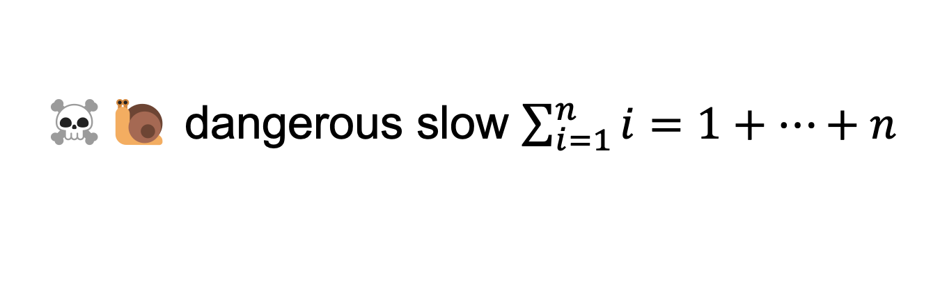
☠️🐌 dangerous slow $\sum_{i=1}^{n}{i}=1+…+n$
// 1 + ... + n
static int sum(int n) {
if (n == 0) return 0;
return n + sum(n - 1);
}

Slide 64
sum(100000)

Slide 65
sum(99999)
sum(100000)

Slide 66
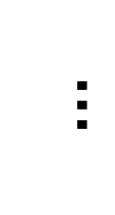
sum(0)
$$…$$
😱 what about this picture does NOT spark joy?
sum(99999)
sum(100000)

Slide 67
the height of the callstack is O(n) 😱 big n → stack overflow! 😞

Slide 68
[sum(100000) demo]

Slide 69
🧠 our depth-first binary (search) tree traversals were recursive... ...should we be worried about them overflowing the callstack?

Slide 70
no. (assuming your tree is ~balanced) callstack height for depth-first balanced binary tree traversal is log(n)
0
1
2
3
4 5
1 1 1 1 1 2 3
0 0 0 0 0 0 0 0 0 0 0
4
5
time

Slide 71
*additionally, some languages/compilers** have "tail-call optimization," which would prevent a stack overflow for sum(100000) **Java is not one of these languages (as our demo showed)

Slide 72
dynamic programming

Slide 73
dynamic programming is when you use the result of previous computation (this is a squishy definition)

Slide 74
F₆
F₄
F₅
F₂
F₃
F₃
F₄
F₀
F₁
F₁
F₂
F₁
F₂
F₂
F₃
F₀
F₁
F₀
F₁
F₀
F₁
F₁
F₂
F₀
F₁

Slide 75
F₆
F₅
F₄
F₄
F₃
F₃
F₂
F₂
F₁
F₁
F₀

Slide 76
F₆
F₅
F₄
F₄
F₃
F₃
F₂
F₂
F₁
F₁
F₀
🧠 who's that
big O runtime?

Slide 77
linear 🙂👍

Slide 78
memoization

Slide 79
memoization means storing the results of previous functions calls, so we don't have to repeat work when the function is called again

Slide 80
🙂 memoized fibonacci
HashMap<Long, Long> table = new HashMap<>();
static long memoizedFib(long k) { // NOTE: long is an integer type
// that can store larger numbers than int
if (k == 0) { return 0; }
if (k == 1) { return 1; }
long Fkm1;
if (table.containsKey(k - 1)) {
Fnm1 = table.get(k - 1);
} else {
Fnm1 = memoizedFib(k - 1);
table.put(k - 1, Fnm1);
}
long Fnm2;
if (table.containsKey(k - 2)) {
Fnm2 = table.get(k - 2);
} else {
Fnm2 = memoizedFib(k - 2);
table.put(k - 2, Fnm2);
}
return Fnm1 + Fnm2;
}
🧠 what's the runtime of each call to memoizedFib(...)?
public static void main(...) {
int n = ...;
long a = memoizedFib(n);
long b = memoizedFib(n - 1);
long c = memoizedFib(n + 1);
}

Slide 81
int n = ...; long a = memoizedFib(n); // O(n) long b = memoizedFib(n - 1); // O(1) long b = memoizedFib(n + 1); // O(1)

Slide 82
👻 closed form fibonacci

Slide 83
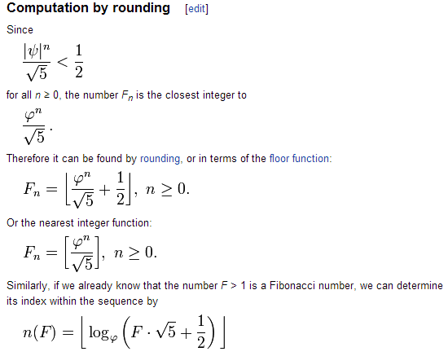

Slide 84
👻 approximate closed-form fibonnaci
// NOTE: Because of floating point error, this does not work for big n.
// (On my computer, returns wrong result for n > 70.)
static long closedFormFib(long n) {
final double goldenRatio = (1.0 + Math.sqrt(5.0)) / 2.0;
return Math.round(Math.pow(goldenRatio, n) / Math.sqrt(5.0));
}

Slide 85
exponentiation by squaring

Slide 86
note: there is actually a log(n) algorithm using matrices and "exponentiation by squaring" this algorithm does NOT have floating point problems (all numbers are integers)

Slide 87
Week10a
✨No Laptop Monday! ✨
binary search
binary search trees
WARMUP
how long does it take to find (search for) something in...
- an array list?
- a linked list?
what if the list is sorted?

Slide 88
[record lecture]

Slide 89
review: sorted

Slide 90
sorted

Slide 91
sorted
a sequence is sorted if its elements are "in order"
by convention, this means ascending order (going up from left to right)
[1, 2, 5, 6, 9, 13] is sorted
[9, 5, 1, 2, 6, 13] is unsorted (NOT sored)

Slide 92
search

Slide 93
search
to search means to look for something (in some data structure)
a simple search problem is finding a given value in an array / list
// get index of the first element in array with this value // returns -1 if value not found int find(int[] array, int value) { ... }
// Option B class FindResult { boolean success; int index; } FindResult find(int[] array, int value) { ... }

Slide 94
linear search (of an array / array list)

Slide 95
linear search (brute force search)
linear search looks at each element one by one
linear search works whether or not the list is sorted
linear search is O(n) (linear time) 😐
// get index of the first element in array with this value // returns -1 if value not found int linearSearch(int[] array, int value) { for (int i = 0; i < array.length; ++i) { if (array[i] == value) { return i; } } return -1; }

Slide 96
example: linear search for 17 [13 2 55 7 17 100 77]

Slide 97
example: linear search for 17 [13 2 55 7 17 100 77]

Slide 98
example: linear search for 17 [13 2 55 7 17 100 77]

Slide 99
example: linear search for 17 [13 2 55 7 17 100 77]

Slide 100
example: linear search for 17 [13 2 55 7 17 100 77]

Slide 101
example: linear search for 17 [13 2 55 7 17 100 77]

Slide 102
example: linear search for 17 [13 2 55 7 17 100 77]

Slide 103
example: linear search for 17 [13 2 55 7 17 100 77]

Slide 104
example: linear search for 17 [13 2 55 7 17 100 77]

Slide 105
example: linear search for 17 [13 2 55 7 17 100 77]

Slide 106
example: linear search for 17 [13 2 55 7 17 100 77]

Slide 108
example: linear search for 17 [1 2 4 5 6 8 9 10 11 13 15 16 17 18 19]

Slide 109
example: linear search for 17 [1 2 4 5 6 8 9 10 11 13 15 16 17 18 19]

Slide 110
example: linear search for 17 [1 2 4 5 6 8 9 10 11 13 15 16 17 18 19]

Slide 111
example: linear search for 17 [1 2 4 5 6 8 9 10 11 13 15 16 17 18 19]

Slide 112
example: linear search for 17 [1 2 4 5 6 8 9 10 11 13 15 16 17 18 19]

Slide 113
example: linear search for 17 [1 2 4 5 6 8 9 10 11 13 15 16 17 18 19]

Slide 114
example: linear search for 17 [1 2 4 5 6 8 9 10 11 13 15 16 17 18 19]

Slide 115
example: linear search for 17 [1 2 4 5 6 8 9 10 11 13 15 16 17 18 19]

Slide 116
example: linear search for 17 [1 2 4 5 6 8 9 10 11 13 15 16 17 18 19]

Slide 117
example: linear search for 17 [1 2 4 5 6 8 9 10 11 13 15 16 17 18 19]

Slide 118
example: linear search for 17 [1 2 4 5 6 8 9 10 11 13 15 16 17 18 19]

Slide 119
example: linear search for 17 [1 2 4 5 6 8 9 10 11 13 15 16 17 18 19]

Slide 120
example: linear search for 17 [1 2 4 5 6 8 9 10 11 13 15 16 17 18 19]

Slide 121
example: linear search for 17 [1 2 4 5 6 8 9 10 11 13 15 16 17 18 19]

Slide 122
example: linear search for 17 [1 2 4 5 6 8 9 10 11 13 15 16 17 18 19]

Slide 123
example: linear search for 17 [1 2 4 5 6 8 9 10 11 13 15 16 17 18 19]

Slide 124
example: linear search for 17 [1 2 4 5 6 8 9 10 11 13 15 16 17 18 19]

Slide 125
example: linear search for 17 [1 2 4 5 6 8 9 10 11 13 15 16 17 18 19]

Slide 126
example: linear search for 17 [1 2 4 5 6 8 9 10 11 13 15 16 17 18 19]

Slide 127
example: linear search for 17 [1 2 4 5 6 8 9 10 11 13 15 16 17 18 19]

Slide 128
example: linear search for 17 [1 2 4 5 6 8 9 10 11 13 15 16 17 18 19]

Slide 129
example: linear search for 17 [1 2 4 5 6 8 9 10 11 13 15 16 17 18 19]

Slide 130
example: linear search for 17 [1 2 4 5 6 8 9 10 11 13 15 16 17 18 19]

Slide 131
example: linear search for 17 [1 2 4 5 6 8 9 10 11 13 15 16 17 18 19]

Slide 132
example: linear search for 17 [1 2 4 5 6 8 9 10 11 13 15 16 17 18 19]

Slide 133
example: linear search for 17 [1 2 4 5 6 8 9 10 11 13 15 16 17 18 19]

Slide 134
example: linear search for 17 [1 2 4 5 6 8 9 10 11 13 15 16 17 18 19]

Slide 135
if we know that an array is sorted... can we search it faster?

Slide 136
yes 🚀

Slide 137
unless it's a linked list 💀

Slide 138
binary search (of a array / array list)

Slide 139
binary search
binary search is an O(log n) algorithm for searching a sorted array 🙂
binary search works by "cutting the array in half" over and over
☠️ binary search only applies if the array is sorted

Slide 140
example: binary search for 17 [1 2 4 5 6 8 9 10 11 13 15 16 17 18 19]

Slide 141
example: binary search for 17 [1 2 4 5 6 8 9 10 11 13 15 16 17 18 19]
10 < 17

Slide 142
example: binary search for 17 [1 2 4 5 6 8 9 10 11 13 15 16 17 18 19]

Slide 143
example: binary search for 17 [1 2 4 5 6 8 9 10 11 13 15 16 17 18 19]
16 < 17

Slide 144
example: binary search for 17 [1 2 4 5 6 8 9 10 11 13 15 16 17 18 19]

Slide 145
example: binary search for 17 [1 2 4 5 6 8 9 10 11 13 15 16 17 18 19]
17 < 18

Slide 146
example: binary search for 17 [1 2 4 5 6 8 9 10 11 13 15 16 17 18 19]

Slide 147
example: binary search for 17 [1 2 4 5 6 8 9 10 11 13 15 16 17 18 19]
17 == 17

Slide 148
example: binary search for 17 [1 2 4 5 6 8 9 10 11 13 15 16 17 18 19]

Slide 149
☠️ implementating binary search is surprisingly tricky! make sure you test thoroughly!

Slide 150
✨ hint: binary search [1 2 4 5 6 8 9 10 11 13 15 16 17 18 19]
[^ 2 4 5 6 8 9 10 11 13 15 16 17 18 ^ ]
[| 2 4 5 6 8 9 10 11 13 15 16 17 18 | ]
[i = 0 4 5 6 8 9 10 11 13 15 16 17 18 j ]

Slide 151
review: binary tree

Slide 152
binary tree

Slide 153
binary tree
a binary tree is a tree in which each node has <= 2 children
10
5
16
2
13
18
1
4
11
15
17

Slide 154
🧠 can a linked list be seen as a binary tree?

Slide 155
technically, yes (assuming no cycles) all nodes have <= 2 children (tail has 0 children, all other nodes have 1 child)

Slide 156
ordered binary tree

Slide 157
(ordered) binary tree
each node has a left child and a right child (either or both children can be null)
10
5
16
node
13
18
11
15
17
node.leftChild
node.rightChild

Slide 158
(ordered) binary tree
each node has a left subtree and a right subtree (and left descendants and right descendants)

Slide 159
binary search tree

Slide 160
binary search tree

Slide 161
binary search tree
in a binary search tree (BST, sorted binary tree) every node follows: "a node's value is greater than the values of all nodes in its left subtree and less than the values of all nodes in its right subtree"
10
5
16
2
13
18
1
4
11
15
17

Slide 162
binary search tree
in a binary search tree (BST, sorted binary tree) every node follows: "a node's value is greater than the values of all nodes in its left subtree and less than the values of all nodes in its right subtree"
10
10 < 16
5
16
5 < 10
2 < 10
10 < 13
2
13
18
10 < 18
1
4
10 < 11
11
15
17
10 < 17
4 < 10
1 < 10
10 < 15

Slide 163
binary search tree
in a binary search tree (BST, sorted binary tree) every node follows: "a node's value is greater than the values of all nodes in its left subtree and less than the values of all nodes in its right subtree"
10
5
16
13 < 16
2
13
18
16 < 18
1
4
11 < 16
11
15
17
16 < 17
15 < 16

Slide 164
binary search tree
in a binary search tree (BST, sorted binary tree) every node follows: "a node's value is greater than the values of all nodes in its left subtree and less than the values of all nodes in its right subtree"
10
5
16
2
13
18
1
4
11
15
17

Slide 165
is it a BST?

Slide 166
2
4
1
3
6
Is It A Binary Search Tree?
4
9
3
5
in a binary search tree (sorted binary tree) every node follows: "a node's value is greater than the values of all nodes in its left subtree and less than the values of all nodes in its right subtree"
2
1
10
5
16
2
8
13
18
1
4
6
9
14
15
17
19

Slide 167
2
4
1
3
6
4
9
3
5
in a binary search tree (sorted binary tree) every node follows: "a node's value is greater than the values of all nodes in its left subtree and less than the values of all nodes in its right subtree"
2
1
10
5
16
2
8
13
18
1
4
6
9
14
15
17
19

Slide 168
binary search (of a binary search tree)

Slide 169
binary search
binary search "cuts a BST in half" over and over
binary search only works when the binary tree is sorted (is a binary search tree)
binary search is O(log n) if the tree is "balanced" 🙂
balanced means each node's children are similar in height (intuitive understanding of this is sufficient; will discuss more on Fri)
10
10
5
16
5
2
8
13
18
2
1
6
9
11
9
1
balanced
NOT balanced

Slide 170
example: binary search for 17 [1 2 4 5 6 8 9 10 11 13 15 16 17 18 19]
10
5
16
2
8
13
18
1
4
6
9
11
15
17
19

Slide 171
example: binary search for 17 [1 2 4 5 6 8 9 10 11 13 15 16 17 18 19]
10
10 < 17
5
16
2
8
13
18
1
4
6
9
11
15
17
19

Slide 172
example: binary search for 17 [1 2 4 5 6 8 9 10 11 13 15 16 17 18 19]
10
5
16
2
8
13
18
1
4
6
9
11
15
17
19

Slide 173
example: binary search for 17 [1 2 4 5 6 8 9 10 11 13 15 16 17 18 19]
10
5
16
16 < 17
2
8
13
18
1
4
6
9
11
15
17
19

Slide 174
example: binary search for 17 [1 2 4 5 6 8 9 10 11 13 15 16 17 18 19]
10
5
16
2
8
13
18
1
4
6
9
11
15
17
19

Slide 175
example: binary search for 17 [1 2 4 5 6 8 9 10 11 13 15 16 17 18 19]
10
5
16
2
8
13
18
17 < 18
1
4
6
9
11
15
17
19

Slide 176
example: binary search for 17 [1 2 4 5 6 8 9 10 11 13 15 16 17 18 19]
10
5
16
2
8
13
18
1
4
6
9
11
15
17
19

Slide 177
example: binary search for 17 [1 2 4 5 6 8 9 10 11 13 15 16 17 18 19]
10
5
16
2
8
13
18
1
4
6
9
11
15
17
19
17 == 17

Slide 178
example: binary search for 17 [1 2 4 5 6 8 9 10 11 13 15 16 17 18 19]
10
5
16
2
8
13
18
1
4
6
9
11
15
17
19

Slide 179
note: a binary search tree is NOT unique let's look at another BST for the same data!

Slide 180
example: binary search for 17 [1 2 4 5 6 8 9 10 11 13 15 16 17 18 19]
2
1
4
5
6
8
9
10
11
13
15
16
17
18
19

Slide 181
example: binary search for 17 [1 2 4 5 6 8 9 10 11 13 15 16 17 18 19]
2
1
4
5
6
8
9
10
11
13
15
16
17
18
19

Slide 182
example: binary search for 17 [1 2 4 5 6 8 9 10 11 13 15 16 17 18 19]
2
1
4
5
6
8
9
10
11
13
15
16
17
18
19

Slide 183
example: binary search for 17 [1 2 4 5 6 8 9 10 11 13 15 16 17 18 19]
2
1
4
5
6
8
9
10
11
13
15
16
17
18
19

Slide 184
example: binary search for 17 [1 2 4 5 6 8 9 10 11 13 15 16 17 18 19]
2
1
4
5
6
8
9
10
11
13
15
16
17
18
19

Slide 185
example: binary search for 17 [1 2 4 5 6 8 9 10 11 13 15 16 17 18 19]
2
1
4
5
6
8
9
10
11
13
15
16
17
18
19

Slide 186
example: binary search for 17 [1 2 4 5 6 8 9 10 11 13 15 16 17 18 19]
2
1
4
5
6
8
9
10
11
13
15
16
17
18
19

Slide 187
example: binary search for 17 [1 2 4 5 6 8 9 10 11 13 15 16 17 18 19]
2
1
4
5
6
8
9
10
11
13
15
16
17
18
19

Slide 188
example: binary search for 17 [1 2 4 5 6 8 9 10 11 13 15 16 17 18 19]
2
1
4
5
6
8
9
10
11
13
15
16
17
18
19

Slide 189
...

Slide 190
life lesson: it is important that your binary search tree is ✨balanced✨ (otherwise your "binary search" degrades into linear search of a linked list ☹️)

Slide 191
adding a new node to a binary search tree (the naive (simple but bad) method)

Slide 192
for a binary search tree, add starts out just like search

Slide 193
just keep going until you hit a null node put the new node there 🙂👍

Slide 194
example: adding 7
10
5
16
2
8
13
18
1
4
6
9
11
15
17
19

Slide 195
example: adding 7
10
5
16
2
8
13
18
1
4
6
9
11
15
17
19

Slide 196
example: adding 7
10
5
16
2
8
13
18
1
4
6
9
11
15
17
19

Slide 197
example: adding 7
10
5
16
2
8
13
18
1
4
6
9
11
15
17
19

Slide 198
example: adding 7
10
5
16
2
8
13
18
1
4
6
9
11
15
17
19

Slide 199
example: adding 7
10
5
16
2
8
13
18
1
4
6
9
11
15
17
19
null

Slide 200
example: adding 7
10
5
16
2
8
13
18
1
4
6
9
11
15
17
19
7

Slide 201
example: adding 7
10
5
16
2
8
13
18
1
4
6
9
11
15
17
19
7

Slide 202
is this approach to adding a new node good? hint: no.

Slide 203
self-balancing binary search trees note: hard to implement

Slide 204


Slide 205
uses of binary search trees

Slide 206
tree map (implement a map)
you can implement the map interface using a BST NOTE: this is NOT a hash map!—no hashing is involved!
class Node {
String key; // NOTE: BST is sorted by key
Integer value;
Node leftChild;
Node rightChild;
}
class TreeMap { Node root;
ValueType get(KeyType) { ... }
void put(ValueType, KeyType) { ... }
}
"Ditto"
132
"Arbok"
24
"Mew"
151

Slide 207
Week10b
✨Wednesday! ✨
WARMUP
what does "sink or swim" mean?
BST traversal order review
heaps, heapsort
ANNOUNCEMENTS
Jim out of town Wed-Fri (TA's will run lab)
Tacos Tacos Tacos tomorrow at 7 pm

Slide 208
review: binary tree depth-first traversal orders

Slide 209
binary tree depth-first traversal orders

Slide 210
depth-first traversal orders (of a binary tree)
pre-order = self, left, right
3, 1, 0, 2, 5, 4, 6
in-order = left, self, right
0, 1, 2, 3, 4, 5, 6
post-order = left, right, self
0, 2, 1, 4, 6, 5, 3
reverse pre-order = self, right, left
3, 5, 6, 4, 1, 2, 0
reverse in-order = right, self, left
6, 5, 4, 3, 2, 1, 0
reverse post-order = right, left, self
6, 4, 5, 2, 0, 1, 3
3
1
5
0
2
4
6

Slide 211
2 * 3
+ 4
who's that
traversal order?
+
in-order!
*
4
2
3

Slide 212
the most satisfying function in CS 136
void recurse(Node self) {
// NOTE: rearranging these 3 lines gives you all
// 3! ("three factorial") = 6 traversal orders
if (self.leftChild != null) { recurse(self.leftChild); }
System.out.print(self.value + " ");
if (self.rightChild != null) { recurse(self.rightChild); }
}

Slide 213
[Live-code traversal orders] (Feel free to follow along or race.)

Slide 214
heaps

Slide 215
always-complete max binary heap

Slide 216
always-complete max binary heap
in this class, when we say "heap" or "max heap", we mean an "always-complete max binary heap"
we might occasionally mention a "min heap", which means an "always-complete min binary heap"

Slide 217
always-complete max binary heap
in a complete binary tree, all levels (depths, rows) are "full of nodes", except for possibly the bottom level, in which all nodes are "as far to to the left as possible"
10
10
5
16
5
16
2
8
13
18
2
8
13
18
1
4
6
9
11
1
4
6
11
complete
(and balanced)
balanced but NOT complete

Slide 218
always-complete max binary heap
in a complete binary tree, all levels (depths) are "full of nodes", except for possibly the bottom level, in which all nodes are "as far to to the left as possible"
10
5
16
2
8
13
18
1
4
6
9
the "last node"
complete
(and balanced)

Slide 219
always-complete max binary heap
"always-complete" means that every function in the Heap interface (add(...) & remove()) "preserves the completeness of the heap"
the heap was complete before calling add...
...and the heap is still complete after add returns
the heap is always complete
always complete.

Slide 220
always-complete max binary heap
a binary heap is another special kind of binary tree
☠️ a binary heap is NOT, in general, a binary search tree

Slide 221
always-complete max binary heap
in a max binary heap, every node follows: "a node's value is greater than the value of its left child and the value of its right child"
27
15
5
7
13
4
2
6
3
11
12
1

Slide 222
always-complete max binary heap
in a max binary heap, every node follows: "a node's value is greater than the value of its left child and the value of its right child"
27
27 > 15
27 > 5
15
5
7
13
4
2
6
3
11
12
1

Slide 223
always-complete max binary heap
in a max binary heap, every node follows: "a node's value is greater than the value of its left child and the value of its right child"
27
15
5
7
13
4
2
6
3
11
12
1
7 > 6
7 > 3

Slide 224
always-complete max binary heap
in a max binary heap, every node follows: "a node's value is greater than the value of its left child and the value of its right child"
🧠 is the "max heap property" above equivalent to...
in a max binary heap, every node follows: "a node's value is greater than the values of all its descendants"
yes.
idea: apply definition recursively
node's value is greater than the values of its children... ...which are greater than the values of their children...
🧠 which node always has the max value of all nodes in the heap?
the root

Slide 225
always-complete max binary heap
in a max binary heap, every node follows: "a node's value is greater than the values of all its descendants"
27
15
5
15 > 7
7
15 > 13
13
4
2
6
3
11
12
1
15 > 6
15 > 3
15 > 11
15 > 12

Slide 226
heap interface add(...) & remove() 🐡 ⚓️ a heap is like a benthic trawl net (ish)

Slide 227
heap interface
// Add this value to the heap. void add(ValueType value) { ... }
// Remove the max value from the heap, and return it. ValueType remove() { ... }

Slide 228
add(...)

Slide 229
void add(ValueType value);
to add a new node with a given value to a max binary heap...
add the new node so that the heap is still complete (add into "the next empty slot")
while that node violates the max heap property...
swap it with its parent
the node "swims up" 🐡
"sifts up"
"heap up"?

Slide 230
example: adding 10
27
15
5
7
13
4
2
6
3
11
12
1

Slide 231
example: adding 10
27
15
5
7
13
4
2
6
3
11
12
1

Slide 232
example: adding 10
27
15
5
7
13
4
2
6
3
11
12
1
10

Slide 233
example: adding 10
27
15
5
7
13
4
2
6
3
11
12
1
10

Slide 234
example: adding 10
27
15
5
7
13
4
2
6
3
11
12
1
10

Slide 235
example: adding 10
27
15
5
7
13
10
2
6
3
11
12
1
4

Slide 236
example: adding 10
27
15
5
7
13
10
2
6
3
11
12
1
4

Slide 237
example: adding 10
27
15
5
7
13
10
2
6
3
11
12
1
4

Slide 238
example: adding 10
27
15
5
7
13
10
2
6
3
11
12
1
4

Slide 239
example: adding 10
27
15
10
7
13
5
2
6
3
11
12
1
4

Slide 240
example: adding 10
27
15
10
7
13
5
2
6
3
11
12
1
4

Slide 241
example: adding 10
27
15
10
7
13
5
2
6
3
11
12
1
4

Slide 242
example: adding 10
27
15
10
7
13
5
2
6
3
11
12
1
4

Slide 243
example: adding 10
27
15
10
7
13
5
2
6
3
11
12
1
4

Slide 244
remove()

Slide 245
ValueType remove();
to remove the node with max value (the root) from a max binary heap...
save the root's value in a temporary variable called result
replace the root with the last node (rightmost node in the bottom level) (the old root is now "garbage" and ready to be garbage collected 🚛)
while that node violates the max heap property...
swap it with its larger child
return result;
the node "sinks down" ⚓️
"sifts down"
"heap down"?

Slide 246
example: removing max node
27
15
5
7
13
4
2
6
3
11
0
1

Slide 247
example: removing max node
int result = root.value;
27
15
5
7
13
4
2
6
3
11
0
1

Slide 248
example: removing max node
27
15
5
7
13
4
2
6
3
11
0
1

Slide 249
example: removing max node
27
15
5
7
13
4
2
6
3
11
0
1

Slide 250
example: removing max node
1
15
5
7
13
4
2
6
3
11
0

Slide 251
example: removing max node
1
15
5
7
13
4
2
6
3
11
0

Slide 252
example: removing max node
1
15
5
7
13
4
2
6
3
11
0

Slide 253
example: removing max node
1
15
5
7
13
4
2
6
3
11
0

Slide 254
example: removing max node
15
1
5
7
13
4
2
6
3
11
0

Slide 255
example: removing max node
15
1
5
7
13
4
2
6
3
11
0

Slide 256
example: removing max node
15
1
5
7
13
4
2
6
3
11
0

Slide 257
example: removing max node
15
1
5
7
13
4
2
6
3
11
0

Slide 258
example: removing max node
15
1
5
7
13
4
2
6
3
11
0

Slide 259
example: removing max node
15
13
5
7
1
4
2
6
3
11
0

Slide 260
example: removing max node
15
13
5
7
1
4
2
6
3
11
0

Slide 261
example: removing max node
15
13
5
7
1
4
2
6
3
11
0

Slide 262
example: removing max node
15
13
5
7
1
4
2
6
3
11
0

Slide 263
example: removing max node
15
13
5
7
11
4
2
6
3
1
0

Slide 264
example: removing max node
15
13
5
7
11
4
2
6
3
1
0

Slide 265
example: removing max node
15
13
5
7
11
4
2
6
3
1
0

Slide 266
example: removing max node
15
13
5
7
11
4
2
6
3
1
0

Slide 267
example: removing max node
15
13
5
7
11
4
2
6
3
1
0
return result;

Slide 268
(implicit) heapsort

Slide 269

because a heap is an always-complete binary tree, we can store a heap "implicitly" as an array using a breadth-first (level-order) traversal!
[ 9 8 7 6 4 1 2 3 5 ]
9
8
7
6
4
1
2
3
5

Slide 270
this lets us do (in-place) implicit heapsort! (using only swaps)

Slide 271
1. build a heap by calling add(...) over and over 2. deconstruct the heap by calling remove() over and over

Slide 272
[ 7 3 2 4 6 1 8 5 9 ]

Slide 273
[ 7 3 2 4 6 1 8 5 9 ]
7

Slide 274
[ 7 3 2 4 6 1 8 5 9 ]
7
3

Slide 275
[ 7 3 2 4 6 1 8 5 9 ]
7
3
2

Slide 276
[ 7 3 2 4 6 1 8 5 9 ]
7
3
2
🐡
4

Slide 277
[ 7 4 2 3 6 1 8 5 9 ]
7
💦
4
2
3

Slide 278
[ 7 4 2 3 6 1 8 5 9 ]
7
4
2
3

Slide 279
[ 7 4 2 3 6 1 8 5 9 ]
7
4
2
🐡
3
6

Slide 280
[ 7 6 2 3 4 1 8 5 9 ]
7
6
💦
2
3
4

Slide 281
[ 7 6 2 3 4 1 8 5 9 ]
7
6
2
3
4

Slide 282
[ 7 6 2 3 4 1 8 5 9 ]
7
6
2
3
4
1

Slide 283
[ 7 6 2 3 4 1 8 5 9 ]
7
6
2
🐡
3
4
1
8

Slide 284
[ 7 6 8 3 4 1 2 5 9 ]
7
🐡
6
8
3
4
1
2

Slide 285
[ 8 6 7 3 4 1 2 5 9 ]
8
💦
6
7
3
4
1
2

Slide 286
[ 8 6 7 3 4 1 2 5 9 ]
8
6
7
3
4
1
2

Slide 287
[ 8 6 7 3 4 1 2 5 9 ]
8
6
7
3
4
1
2
🐡
5

Slide 288
[ 8 6 7 5 4 1 2 3 9 ]
8
6
7
💦
5
4
1
2
3

Slide 289
[ 8 6 7 5 4 1 2 3 9 ]
8
6
7
5
4
1
2
3

Slide 290
[ 8 6 7 5 4 1 2 3 9 ]
8
6
7
5
4
1
2
🐡
3
9

Slide 291
[ 8 6 7 9 4 1 2 3 5 ]
8
6
7
🐡
9
4
1
2
3
5

Slide 292
[ 8 9 7 6 4 1 2 3 5 ]
8
🐡
9
7
6
4
1
2
3
5

Slide 293
[ 9 8 7 6 4 1 2 3 5 ]
💦
9
8
7
6
4
1
2
3
5

Slide 294
[ 9 8 7 6 4 1 2 3 5 ]
9
8
7
6
4
1
2
3
5

Slide 295
[ 9 8 7 6 4 1 2 3 5 ]
9
8
7
6
4
1
2
3
5

Slide 296
[ 5 8 7 6 4 1 2 3 9 ]
⚓️
5
8
7
6
4
1
2
3

Slide 297
[ 8 5 7 6 4 1 2 3 9 ]
8
⚓️
5
7
6
4
1
2
3

Slide 298
[ 8 6 7 5 4 1 2 3 9 ]
8
6
7
💦
5
4
1
2
3

Slide 299
[ 8 6 7 5 4 1 2 3 9 ]
8
6
7
5
4
1
2
3

Slide 300
[ 8 6 7 5 4 1 2 3 9 ]
8
6
7
5
4
1
2
3

Slide 301
[ 3 6 7 5 4 1 2 8 9 ]
3
⚓️
6
7
5
4
1
2

Slide 302
[ 7 6 3 5 4 1 2 8 9 ]
7
💦
6
3
5
4
1
2

Slide 303
[ 7 6 3 5 4 1 2 8 9 ]
7
6
3
5
4
1
2

Slide 304
[ 7 6 3 5 4 1 2 8 9 ]
7
6
3
5
4
1
2

Slide 305
[ 2 6 3 5 4 1 7 8 9 ]
⚓️
2
6
3
5
4
1

Slide 306
[ 6 2 3 5 4 1 7 8 9 ]
6
⚓️
2
3
5
4
1

Slide 307
[ 6 5 3 2 4 1 7 8 9 ]
6
5
3
💦
2
4
1

Slide 308
[ 6 5 3 2 4 1 7 8 9 ]
6
5
3
2
4
1

Slide 309
[ 6 5 3 2 4 1 7 8 9 ]
6
5
3
2
4
1

Slide 310
[ 1 5 3 2 4 6 7 8 9 ]
⚓️
1
5
3
2
4

Slide 311
[ 5 1 3 2 4 6 7 8 9 ]
5
1
⚓️
3
2
4

Slide 312
[ 5 4 3 2 1 6 7 8 9 ]
5
4
3
💦
2
1

Slide 313
[ 5 4 3 2 1 6 7 8 9 ]
5
4
3
2
1

Slide 314
[ 5 4 3 2 1 6 7 8 9 ]
5
4
3
2
1

Slide 315
[ 1 4 3 2 5 6 7 8 9 ]
⚓️
1
4
3
2

Slide 316
[ 4 1 3 2 5 6 7 8 9 ]
4
⚓️
1
3
2

Slide 317
[ 4 2 3 1 5 6 7 8 9 ]
4
2
3
💦
1

Slide 318
[ 4 2 3 1 5 6 7 8 9 ]
4
2
3
1

Slide 319
[ 4 2 3 1 5 6 7 8 9 ]
4
2
3
1

Slide 320
[ 1 2 3 4 5 6 7 8 9 ]
1
⚓️
2
3

Slide 321
[ 3 2 1 4 5 6 7 8 9 ]
3
💦
2
1

Slide 322
[ 3 2 1 4 5 6 7 8 9 ]
3
2
1

Slide 323
[ 3 2 1 4 5 6 7 8 9 ]
3
2
1

Slide 324
[ 1 2 3 4 5 6 7 8 9 ]
⚓️
1
2

Slide 325
[ 2 1 3 4 5 6 7 8 9 ]
2
💦
1

Slide 326
[ 2 1 3 4 5 6 7 8 9 ]
2
1

Slide 327
[ 2 1 3 4 5 6 7 8 9 ]
2
1

Slide 328
[ 1 2 3 4 5 6 7 8 9 ]
1

Slide 329
[ 1 2 3 4 5 6 7 8 9 ]
1

Slide 330
[ 1 2 3 4 5 6 7 8 9 ]
1

Slide 331
[ 1 2 3 4 5 6 7 8 9 ]

Slide 332
heap application: priority queue

Slide 333

review: queue
remove();

Slide 334
review: queue
remove();

Slide 335
review: queue
add();

Slide 336
review: queue
add();

Slide 337
review: queue
remove();

Slide 338
review: queue

Slide 339
extension: priority queue

Slide 340

extension: priority queue

Slide 341

extension: priority queue
priority 1

Slide 342

extension: priority queue
priority 1
priority 1

Slide 343

extension: priority queue
priority 9
priority 1
priority 1

Slide 344

extension: priority queue
priority 9
priority 1
priority 1
priority 5

Slide 345

extension: priority queue
priority 999
priority 9
priority 1
priority 1
priority 5

Slide 346
extension: priority queue
priority 999
priority 9
priority 1
priority 1
priority 5

Slide 347
a priority queue's remove() function removes the element with highest priority

Slide 348
a max heap's remove() function removes the node with maximum value

Slide 349
✨ a max heap is a natural way to implement a priority queue ✨

Slide 350
Week09a
✨No Laptop Monday Funday! ✨
🦜🦜🦜
🦜🦜🦜
🦜🦜🦜
directed graph preview
trees
BOTANY WARMUP
what is a tree?
what is a branch?
what is a node?
ADDITIONAL WARMUP
what does binary mean?
what is a binary tree?
what does ternary mean?
[record lecture]

Slide 351
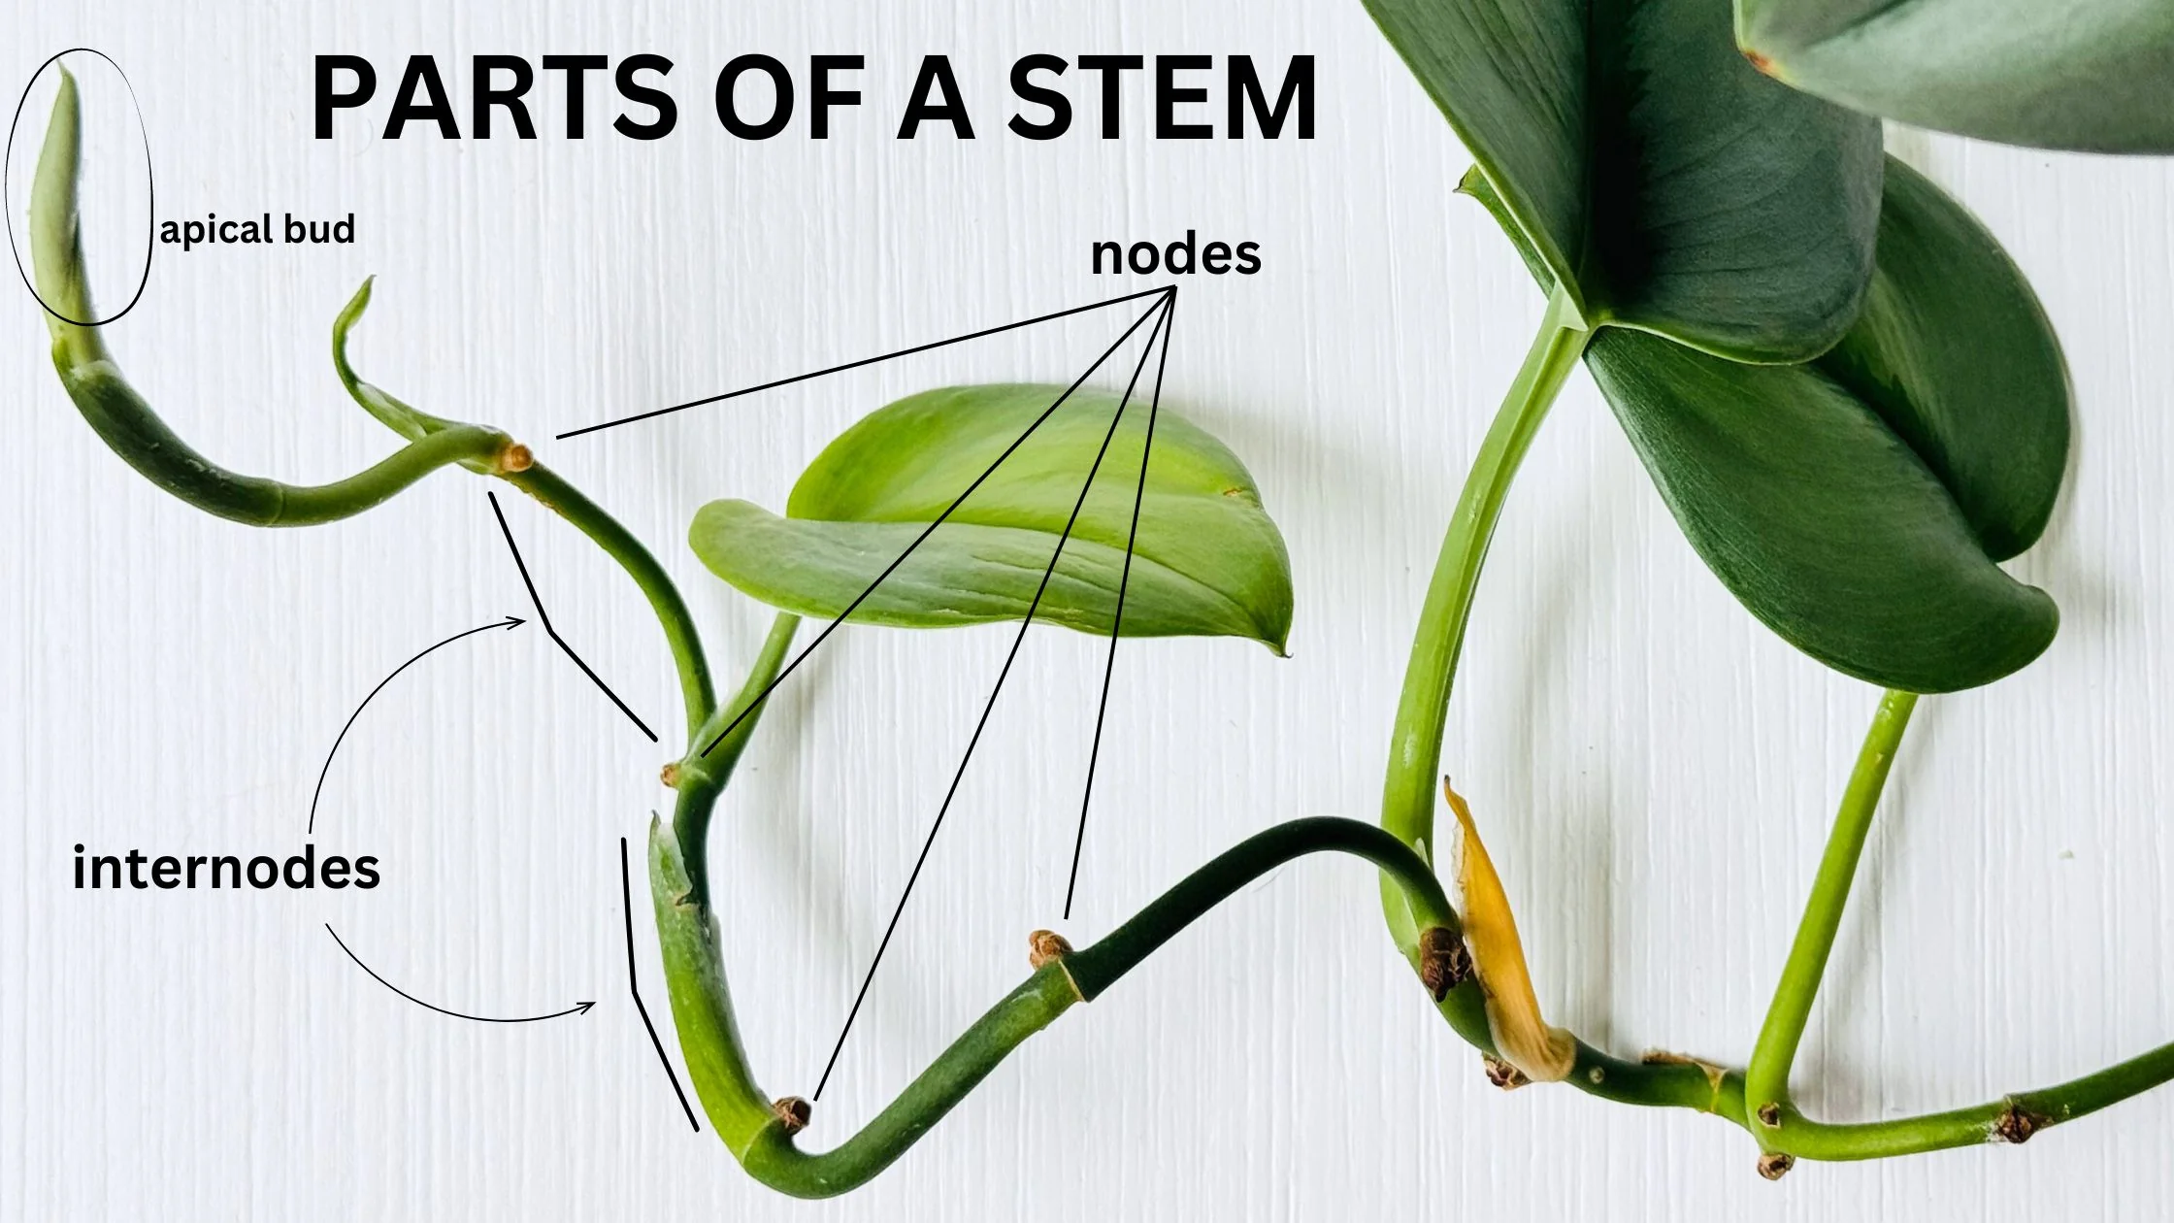

Slide 352
directed graphs

Slide 353
quick note: Math vs. CS

Slide 354
CS vs. Math
a directed graph is a data structure
it has nodes that refer to any number of other nodes
a directed graph G = (V, E) is also a mathematical object
it has vertices (nodes) V
it has directed edges E
note: E is a set of 2-tuples

Slide 355
these are really just two different ways of looking at the same thing

Slide 356
both are useful! (Math to figure out the algorithm, CS to code it up)

Slide 357
in CSCI 136, i will focus on the CS view (MATH 200, CSCI 256 will look at the Math side)

Slide 358
🙂👍

Slide 359
directed graph

Slide 360
the directed graph generalizes the linked list
a node in a directed graph has references to any number of other nodes
nodes are drawn as circles
references are drawn as arrows
let's not worry about
whether this is allowed
or whether this is allowed

Slide 361
(whether we allow for self-edges, multiple edges, etc. depends on context)

Slide 362
🙂👍

Slide 363
tree

Slide 364
kinship terminology (parent, child, etc.)

Slide 365
kinship terminology is useful for describing trees
a node has references to other nodes
it is their parent
they are its children

Slide 366
(directed) tree

Slide 367
a (directed) tree is a directed graph that...
has exactly one node with zero parents (the root)
has no nodes with more than one parent
has no cycles (loops) of any kind
is connected (just one tree, not multiple disconnected trees)
(otherwise, it would be a forest)
5
16
2
2
2
13
18
1
4
11
15
19

Slide 368
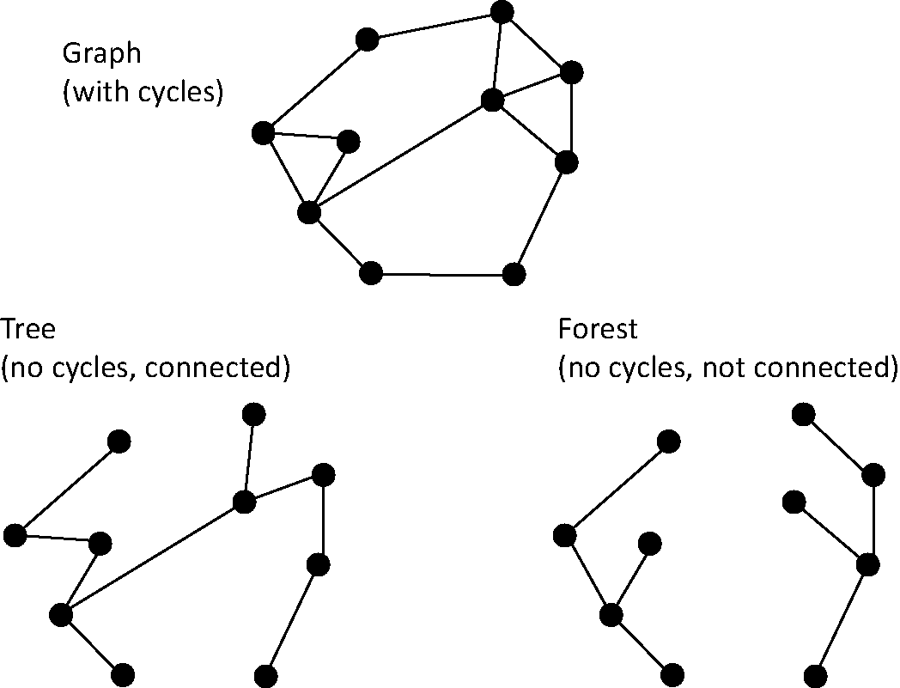
note: not joking

Slide 369
Monday Funday

Slide 370
time for everyone's favorite home game...

Slide 371
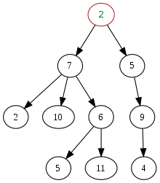
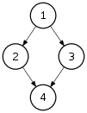
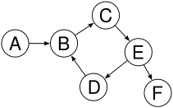
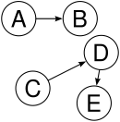

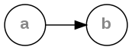
is it a tree?
yes
no
violates 2 & 3
tree rules
exactly one node with zero parents
no node with more than one parent
no cycles
is connected
no
violates 2 & 3
no
violates 1 & 4
no
violates 1 & 3
yes

Slide 372
is it a tree?
yes

Slide 373

can be seen as

Slide 374
uses of trees

Slide 375
simplifying expressions

Slide 376
(2 + 3)
* 4
*
+
4
2
3

Slide 377
5
* 4
*
5
4

Slide 378
20
20

Slide 379
!
(true && )
(false || true)
!
&&
true
||
false
true

Slide 380
!
(true && true)
!
&&
true
true

Slide 381
!true
!
true

Slide 382
false
false

Slide 383
and so much more!

Slide 384
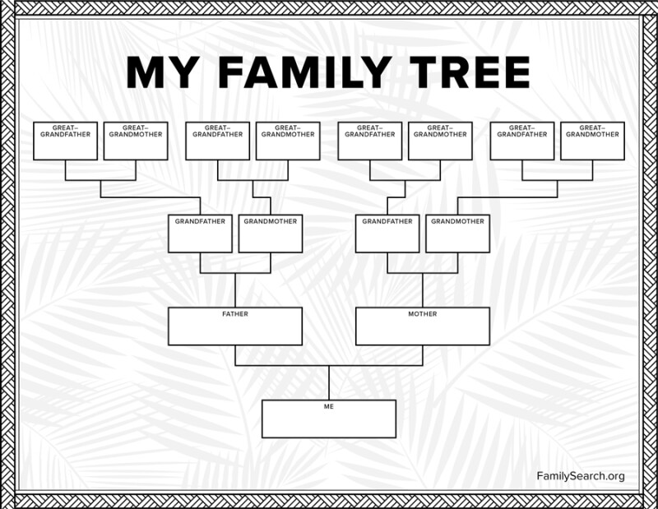

Slide 385
careful: these nodes are
the children of
the node with value jim
jim
jim's mom
jim's dad
jim's mom's mom
jim's mom's dad
jim's dad's mom
jim's dad's dad

Slide 386
note: family trees considered deeply confusing; let us never talk of them again 🙅

Slide 387
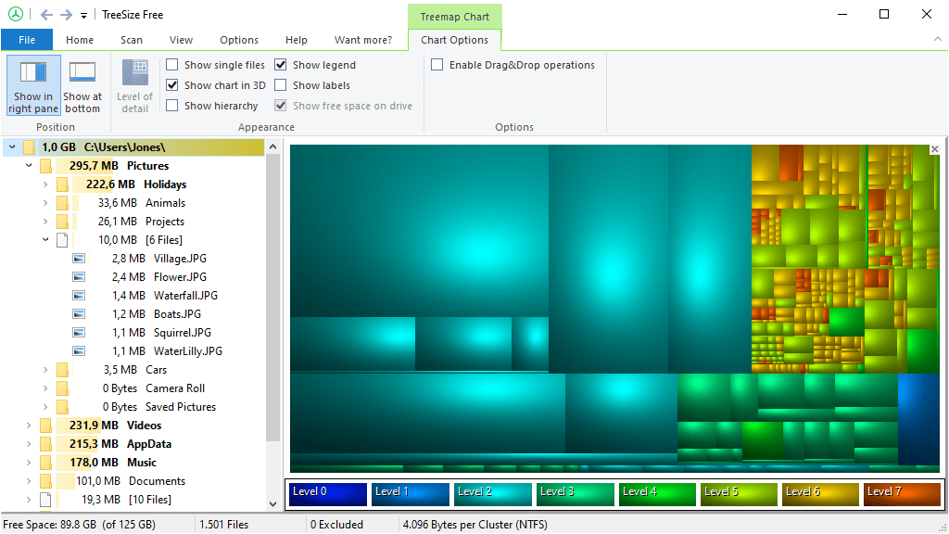
File System (TreeSize Free)
https://www.jam-software.com/treesize_free

Slide 388

Transformation Hierarchy (Blender)
https://15466.courses.cs.cmu.edu/lesson/hierarchy

Slide 389
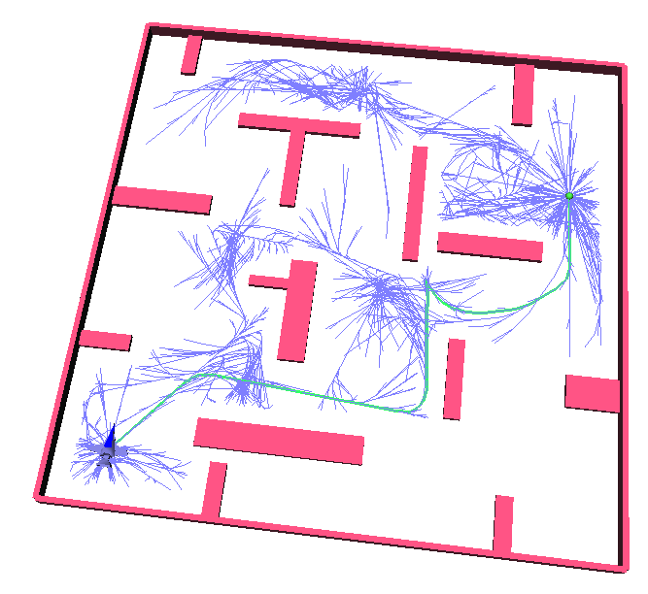
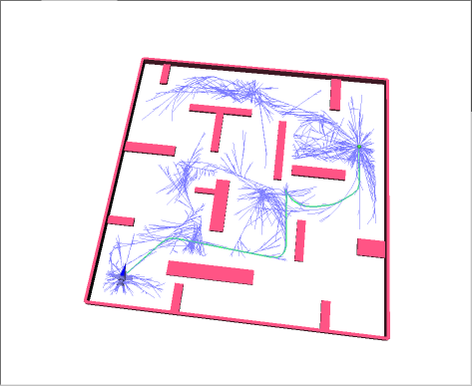
Rapidly Exploring Random Trees (RRTs)
Randomized Kinodynamic Planning by Steven M. LaValle and James J. Kuffner, Jr., International Journal of Robotics Research, 20(5):378--400, May 2001

Slide 390
Hierplane (Mark)

Slide 391
[homework preview]

Slide 392
different ways to implement trees

Slide 393
ArrayList<Node> children; Node leftChild; Node rightChild; Node[] children;

Slide 394
Week09b
✨Laptop Wednesday! ✨
for-each loop
tree terminology
terrific tree traversal tutorial
BONUS WARMUP
evaluate this expression tree
🦜🦜🦜
🦜🦜🦜
🦜🦜🦜
WARMUP
what does depth mean?
what does breadth mean?
what does first mean?

Slide 395
[address the election?]

Slide 396
[record lecture]

Slide 397
☠️ for-each loop

Slide 398
☠️ for-each loop

Slide 399
🐍 Python's for loop is a for-each loop
lst = [ True, 5.0, "Hello" ]
for element in lst: # for each item in the list...
print(element)

Slide 400
a for-each loop can be a convenient alternative to a for loop
for (int turretIndex = 0; turretIndex < turrets.length; ++turretIndex) {
Turret turret = turrets[turretIndex];
...
}
for (Turret turret : turrets) { // for each turret in turrets...
...
}

Slide 401
a for-each loop can be a convenient alternative to a for loop
for (int strokeIndex = 0; strokeIndex < currentFrame.size(); ++strokeIndex) {
ArrayList<Point> stroke = currentFrame.get(strokeIndex);
for (int pointIndex = 0; pointIndex < stroke.size(); ++pointIndex) {
Point point = stroke.get(pointIndex);
...
}
}
for (ArrayList<Point> stroke : currentFrame) {
for (Point point : stroke) {
...
}
}
forgive me 🥲
i swear all that indexing built character

Slide 402
for-each can be convenient but...

Slide 403
you never *need* a for-each loop (some languages don't even have one)

Slide 404
☠️ for-each loops can get you into trouble if you don't fully understand how references and Objects work in Java

Slide 405
☠️ for-each loop dangers
☠ a for-each loop provides a "convenient reference"
☠ LESS powerful than a regular for loop
for (int i = 0; i < things.length; ++i) {
Thing thing = things[i]; // thing is a "convenient reference"
...
}
for (Thing thing : things) { // thing is a "convenient reference"
...
}

Slide 406
☠️ for-each loop dangers
for (int i = 0; i < things.length; ++i) {
things[i] = new Thing(); // does write to array 🙂👍
}
for (int i = 0; i < things.length; ++i) {
Thing thing = things[i]; // thing is a "convenient reference"
thing = new Thing(); // does NOT write to array
}
for (Thing thing : things) { // thing is a "convenient reference"
thing = new Thing(); // does NOT write to array
}

Slide 407
☠️ for-each loop for iterating over a String
in Java, a for-each loop can iterate through String's with toCharArray()
☠ toCharArray() is O(n), but fine for CSCI 136
for (char c : string.toCharArray()) {
...
}

Slide 408
more tree terminology

Slide 409
more tree terminology

Slide 410


Slide 412
the root has no parents a leaf has no children
root
5
16
2
13
18
leaves

Slide 413
a path is a chain of distinct edges
16
path
13
18

Slide 414
a node's depth is the number of edges in the path from the root to that node
depth 0
5
16
depth 1
2
13
18
depth 2
depth 3

Slide 415
level means either depth or (depth + 1) depending on who you ask 🤷‍♀️

Slide 416
tree traversal

Slide 417
breadth-first vs. depth-first

Slide 418

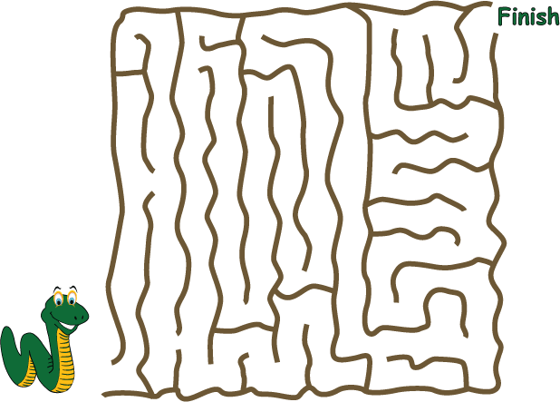
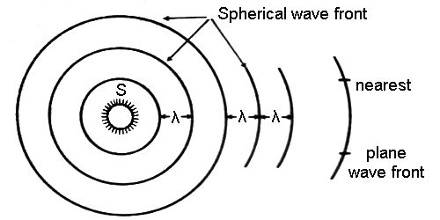
breadth-first vs. (pre-order) depth-first
"a persistent, optimistic, very thorough worm" –Mark Hopkins

Slide 419
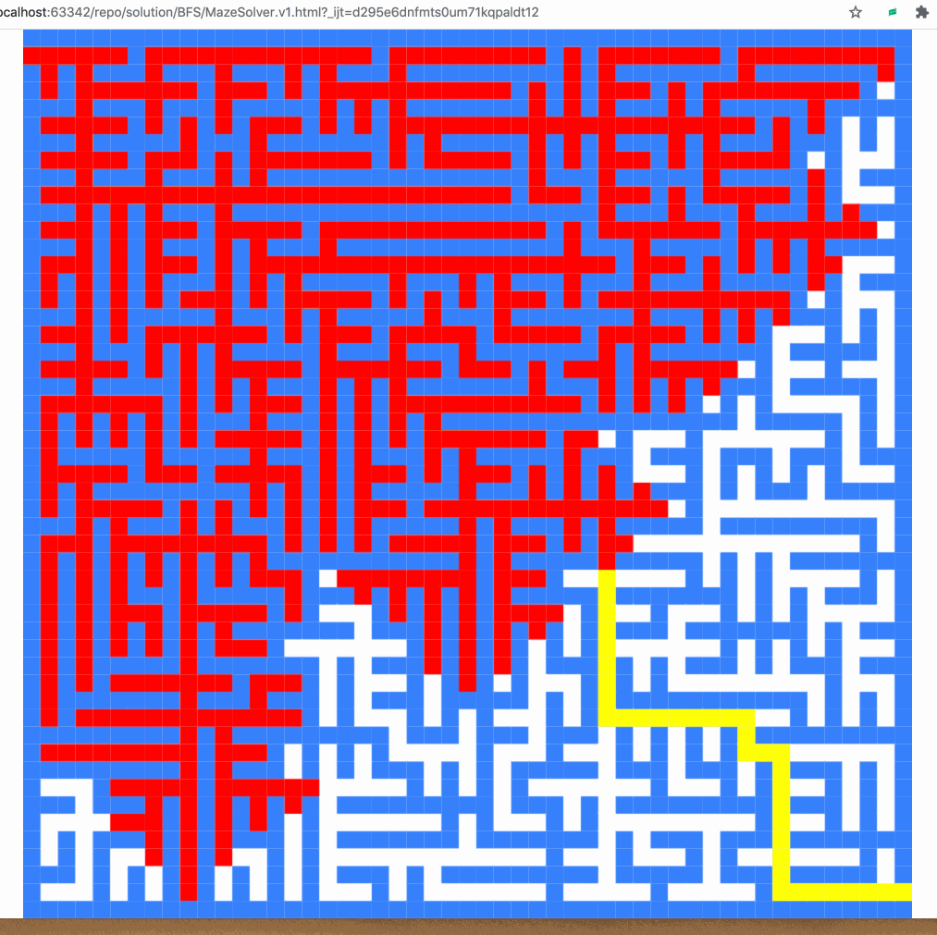
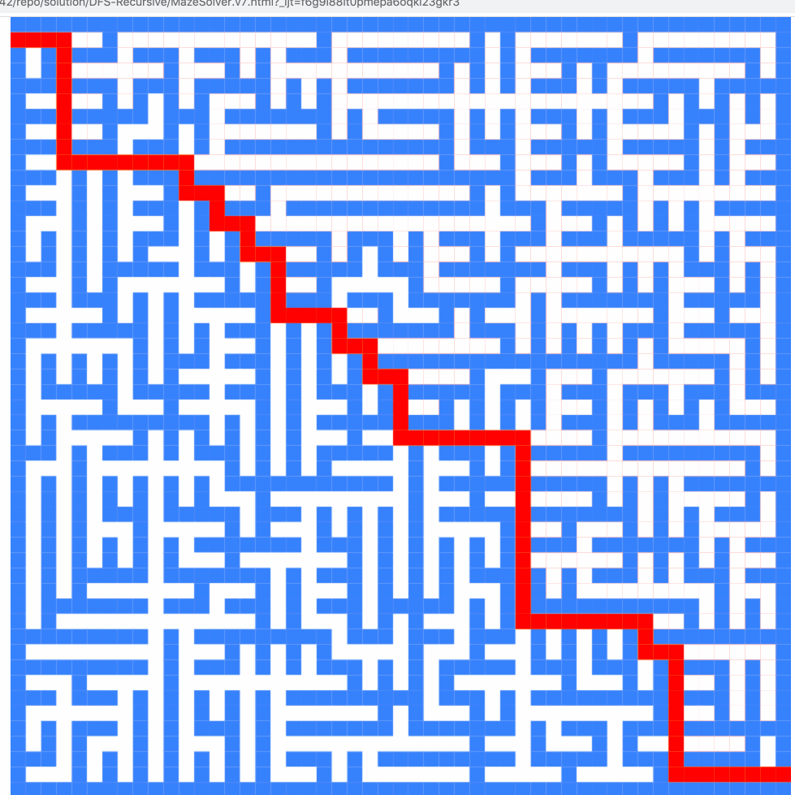
breadth-first vs. (pre-order) depth-first

Slide 420
breadth-first vs. (pre-order) depth-first
0
0
1
2
3
1
2
3
4
5
4
5
6
6
0
1
2
3
4
5
6
0
1
4
6
5
2
3

Slide 421
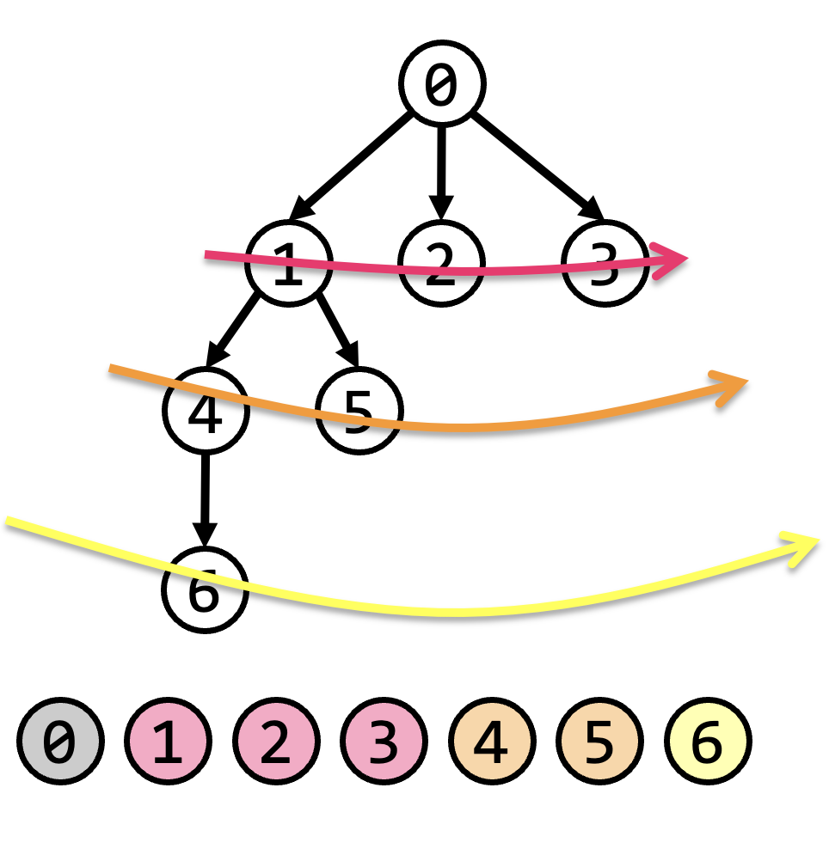
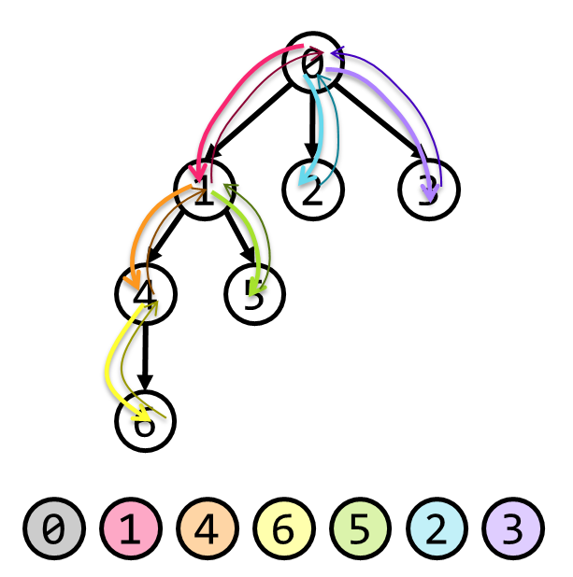
tree traversal (walking the tree)
tree traversal means iterating through all of the tree's nodes
breadth-first first explores as broadly (widely) as possible
one level (depth) at a time
uses a queue
depth-first first explores as deeply as possible
one root-to-leaf path at a time
uses a stack (or recursion, which uses the callstack)
☠ there are actually many different variants of depth-first traversal (i will explain them when we get to binary trees)

Slide 422
why might we want to traverse a tree? why did we want to traverse a linked list? do we ever *traverse* an array?

Slide 423
gathering all words in a trie (HW09)
searching for something (HW10?)
evaluating an expression tree
gathering all the nodes into a list (Tut09)

Slide 424
Terrific Tree Traversal Tutorial

Slide 425
explanation

Slide 426
Week09c
Friday.
trees vs. graphs
WARMUP
have you ever played the game Worms World Party?
how would you implement it?

Slide 427
[record lecture]

Slide 428
Terrific Tree Traversal Tutorial treview

Slide 429
traverseBreadthFirst
change color to indicate
hasBeenVisited = true
0 added to queue
0 removed from queue
1 added to queue
2 added to queue
3 added to queue
1 removed from queue
4 added to queue
5 added to queue
2 removed from queue
3 removed from queue
6 added to queue
4 removed from queue
5 removed from queue
6 removed from queue
7 added to queue
7 removed from queue
0
1
2
3
4
5
6
queue.add(root)
while queue not empty:
curr = queue.remove()
... # process curr
for child in curr.children:
queue.add(child)
7
0
1
2
3
4
5
6
7

Slide 430
traversePreOrderDepthFirst
change color to indicate
hasBeenVisited = true
start recurse(0)
start recurse(1)
start recurse(4)
finish recurse(4)
start recurse(5)
finish recurse(5)
finish recurse(1)
start recurse(2)
finish recurse(2)
start recurse(3)
start recurse(6)
start recurse(7)
finish recurse(7)
finish recurse(6)
finish recurse(3)
finish recurse(0)
0
1
2
3
4
5
6
def recurse(curr):
... # process curr
for child in curr.children:
recurse(child)
7
recurse(root)
0
1
4
5
2
3
6
7

Slide 431
example: two a-maze-ing mazes

Slide 432
maze A

Slide 433
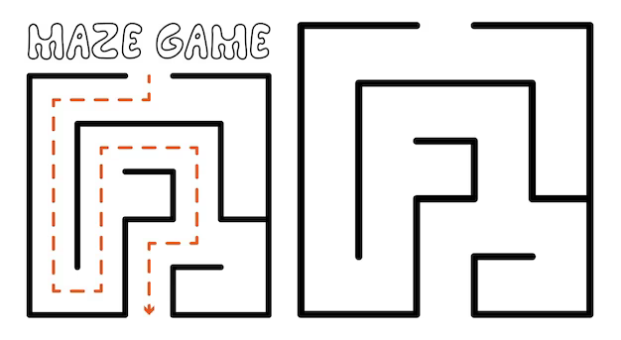

start
finish

Slide 465
maze B

Slide 466
start
finish

Slide 467


Slide 469
[worms world party]

Slide 470
trees vs. graphs

Slide 471
the problem with naively traversing a graph

Slide 472
directed cycles (loops) in the graph will create infinite loops in your code

Slide 473
[example (live coding)]
0
1
2
3

Slide 474
how to traverse a graph

Slide 475
to traverse a graph, you need to keep track of which nodes you have visited
Option A: Store a boolean called hasBeenVisited on each Node.
Option B: Use another data structure to keep track of visited nodes.
for example, HashMap<Node, Boolean> hasNodeBeenVisited;
or even better (smaller), HashSet<Node> visitedNodes;

Slide 476
example: traversing a graph with a directed cycle
1
2
3

Slide 477
example: flood fill 🪣

Slide 478
quadtree rabbit hole 🐰

Slide 479
problem: naive collision detection is slow O(n^2) to check all pairs

Slide 480
idea: use a grid O(n) to assign all circles to grid cells

Slide 481
problem: so many grid cells; most empty!

Slide 482
idea: "only have grid where you need it"

Slide 483
problem: how do we store this?

Slide 484
idea: a tree

Slide 485
idea: a tree

Slide 486
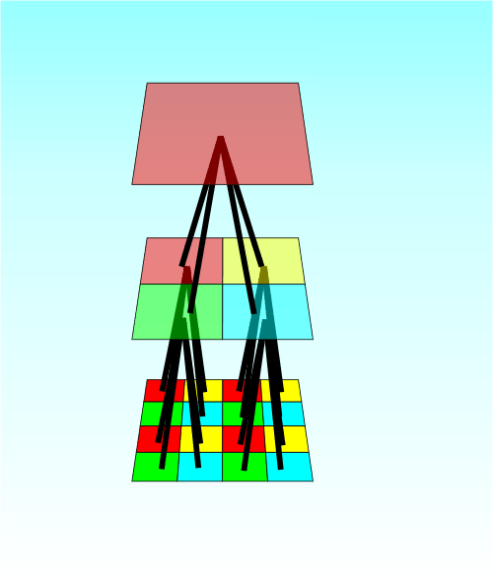

Slide 487
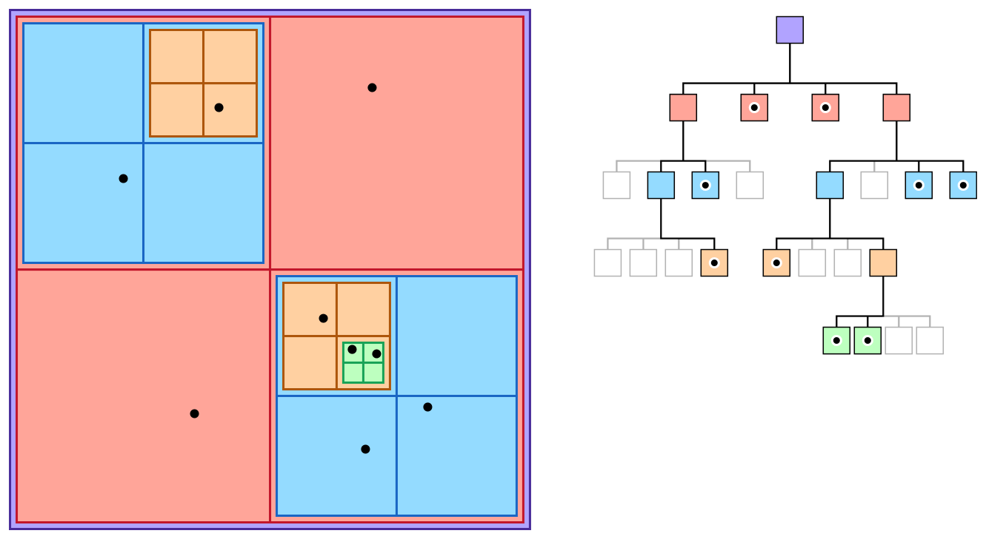

Slide 488
quadtree reading

